Slide 1
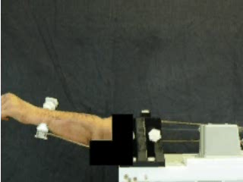
Horizontal Flexion

Slide 2
Horizontal Flexion

Slide 3
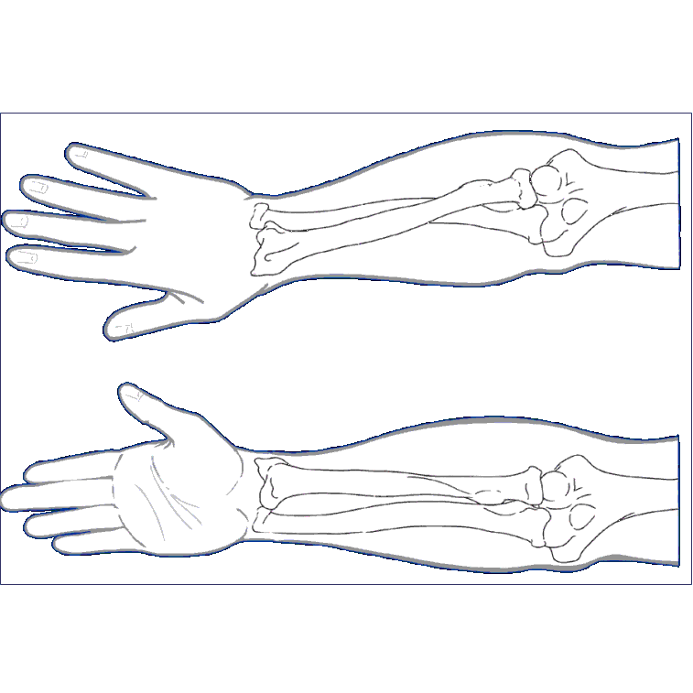
Kinematic Pathways
Valgus
Angulation
Notes:
valgus angulation of the ulna relative to the humerus

Slide 4


Valgus Angulation Pathways
Vertical
Valgus Angle (deg)
Flexion Angle (deg)
Active
Passive
Horizontal
Valgus Angle (deg)
Flexion Angle (deg)
Notes:
CHANGE TITLES

Slide 5


Valgus Angulation Pathways
Valgus
Valgus Angle (deg)
g
Flexion Angle (deg)
Active
Passive
Varus
Valgus Angle (deg)
g
Flexion Angle (deg)

Slide 6
FUTURE RESEARCH DIRECTIONS

Slide 7
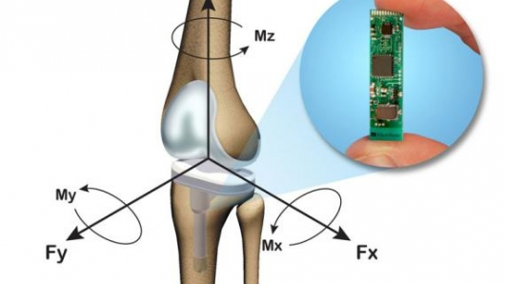
In-Situ Transducers
MicroStrain®
Notes:
Transducers have been developed which can be implanted in-situ.
Here is an example of a knee implant outfitted with a MicroStrain wireless transducer that reports multi-axis forces and torques.

Slide 8
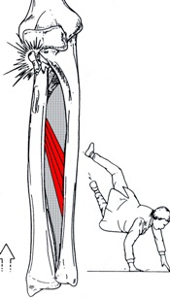
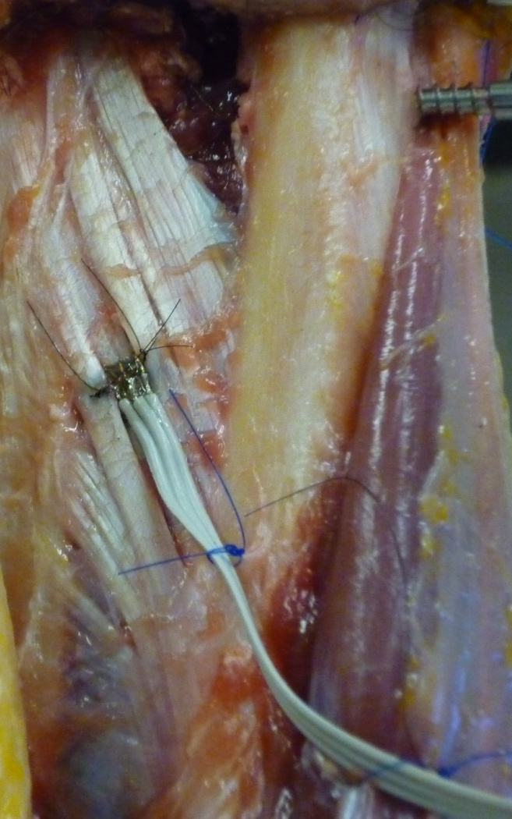
Rationale for Work
Notes:
By suturing this strain-gauge based transducer directly into the fibres of the central band of the IOM,
we were able to measure IOM tension directly for intact specimens, as well as for injury and repair models.

Slide 9
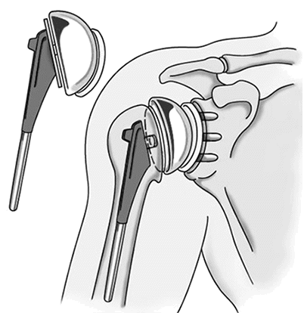
Shoulder Replacement
Replacement of the natural ball & socket joint with artificial components
Glenoid
Component
Humeral
Component

Slide 10
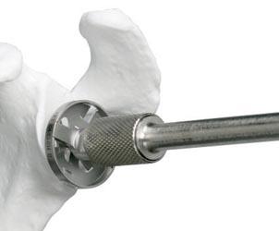
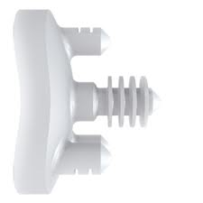
Glenoid Surface Preparation
Ream to match implant backing curvature

Slide 11
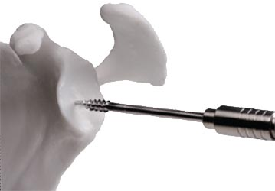
Glenoid Surface Preparation
Drill holes for posts

Slide 12
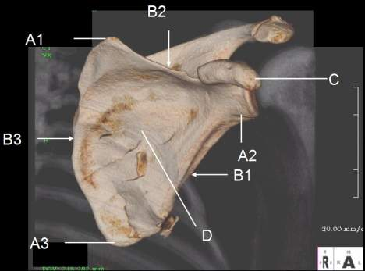
Pre-Operative Plan
Notes:
Using a surface model of the scapula generated from the patient’s CT scan, and a virtual model of the glenoid implant,
The surgeon can virtually place the glenoid in the desired location.
We do this routinely in the lab.
The negative volume intersecting the implant and glenoid is determined and a milling path is calculated.

Slide 13
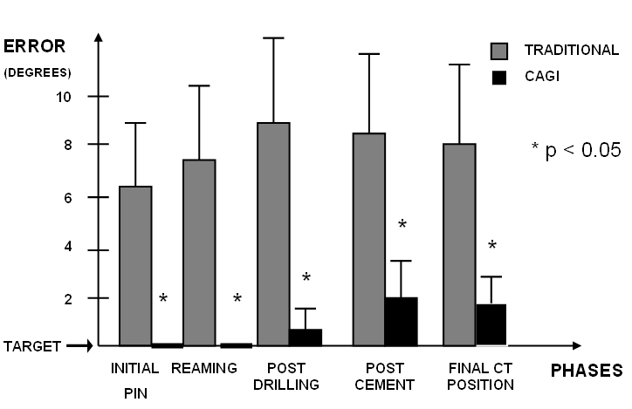
Glenoid Orientation Error
Very difficult to achieve desired orientation
Nguyen et al. J Shoulder Elbow Surg. 2009.
Notes:
In a study comparing traditional manual implantation (shown in grey) vs computer-assisted glenoid implantation (in black),
We showed that even experienced shoulder surgeons produced significantly more orientation error at various stages throughout implantation.

Slide 14
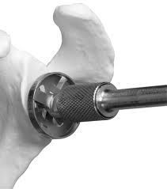
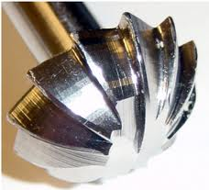
Large Reaming Tool

Slide 15
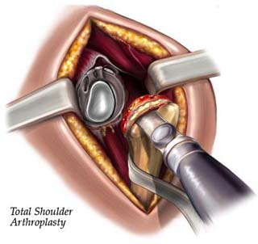
Need Large Incision

Slide 16
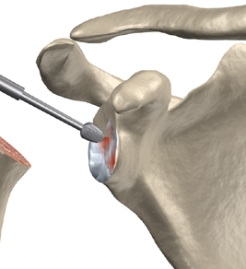
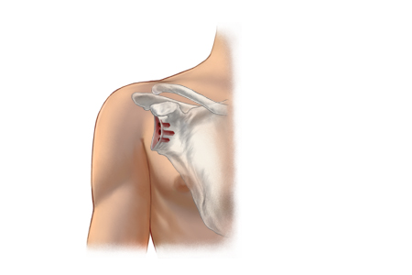
Minimally Invasive
Notes:
Once the surgeon introduces the milling robot into the surgical site and the position of the patient’s glenoid is determined,
Then the milling robot would procedure to mill out the bone necessary to accommodate the glenoid implant.

Slide 17
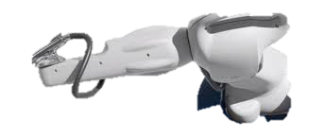
Robotic Glenoid Milling
Requires much less exposure

